Slide 1


183 DB Weekly Report
Week3 Team Parsley
Lin Li, Amir Omidfar, Wilson Chang, Angel Jimenez

Slide 2

Simulation
Finished building 3D structure and environment for the simulation.
2. Tested several basic motions in the simulation world.
Video Link: https://www.youtube.com/watch?v=kcwpM1wRnxU&feature=youtu.be

Slide 3
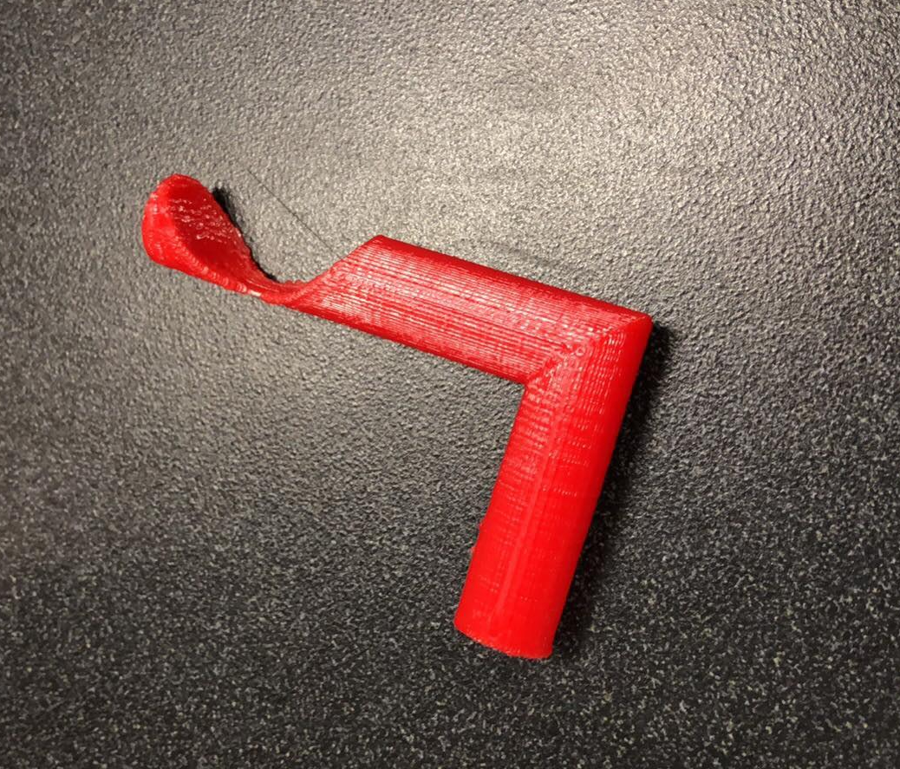
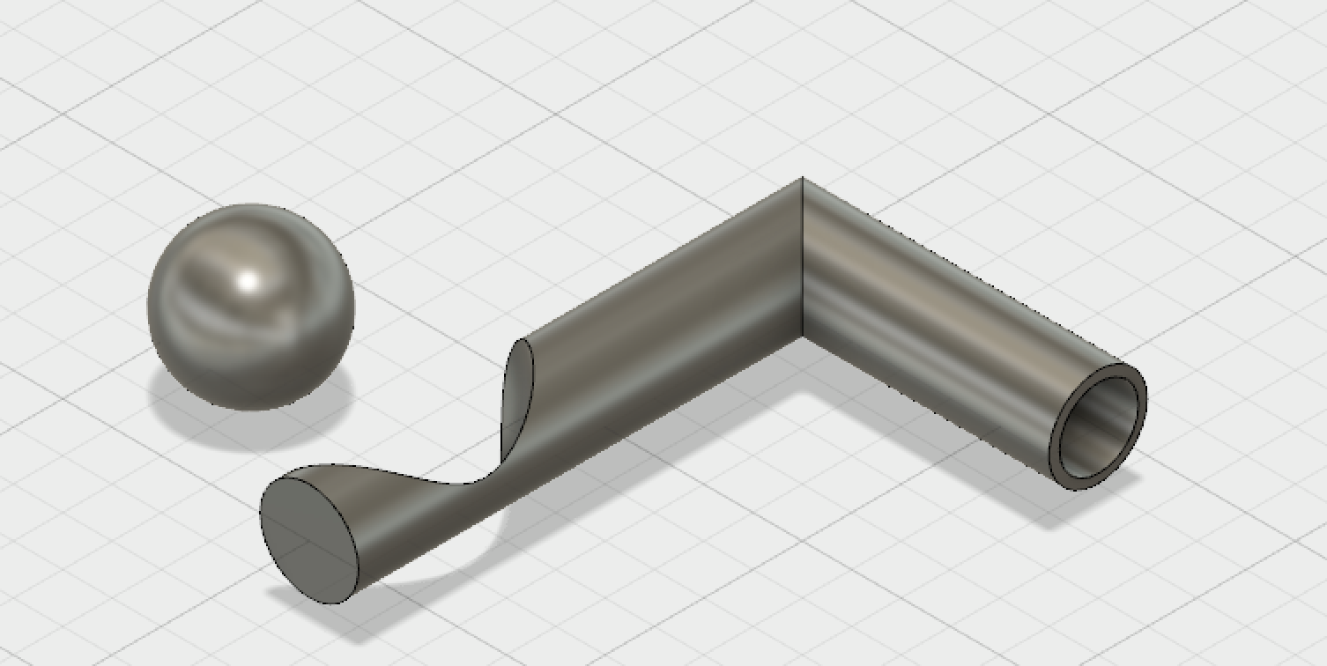
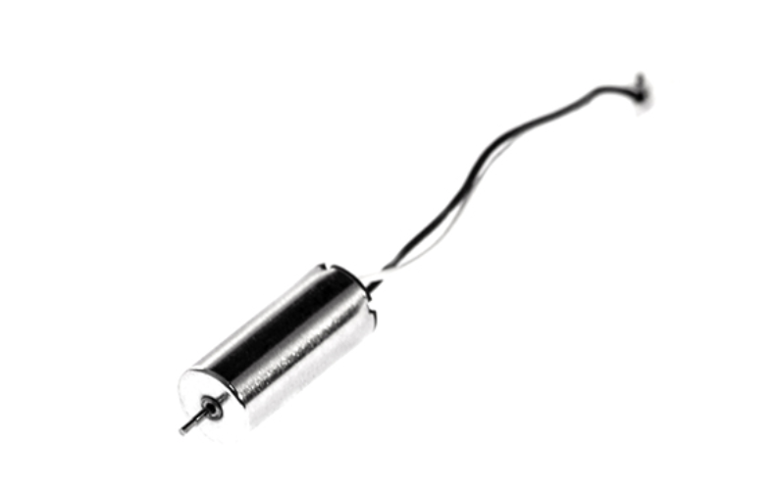
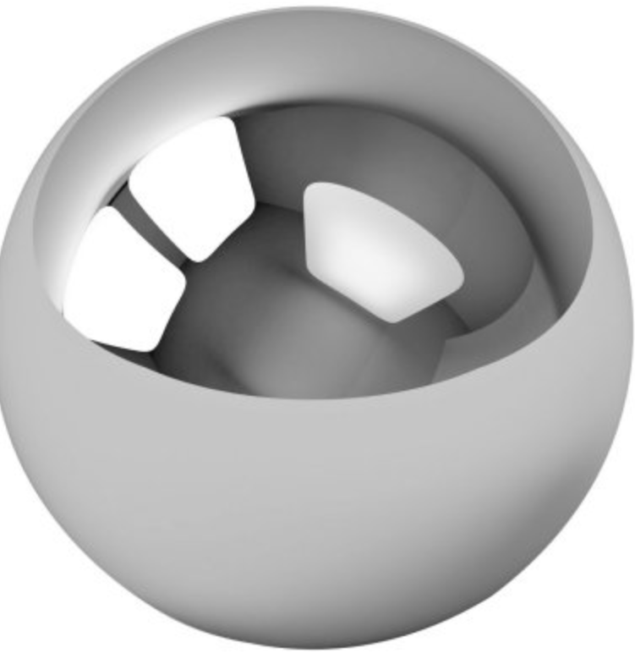
Rotating Arm 3D print
Designed in Fusion 360
Max Payload | 15 g
Motor weight | 2.7g
Spinning mass | <10g

Slide 4
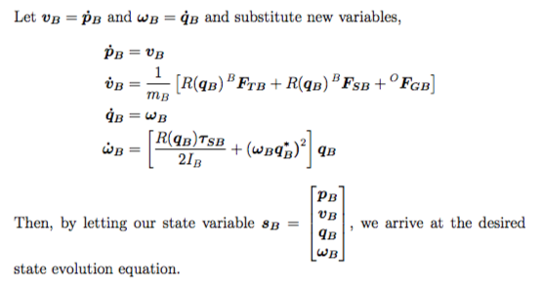
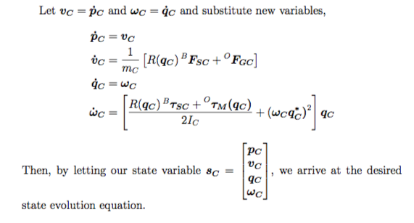
Documentation

Slide 5
Next Week Planning
Derive the right controller model to implement on the drone
Calibrate and correct the model based on the data got from running simulation

